Slide 1

Wasserstein Deep Convolutional Generative Learning Adversarial Network for Dynamic Sparse Sampling (WDC-GLANDSS)
David S. Helminiak
Marquette University Opus College of Engineering
EECE 6822 – Final Project
1 May 2019
Notes:
Salutations and felicitations, I am David Helminiak and today I will be presenting on the development of the Wasserstein deep convolutional generative learning adversarial network for dynamic sparse sampling.

Slide 2
Motivation - Scanning Problem
Acquisition of high resolution data
0.5-5 seconds per pixel depending on scanning method
Reduction of radiation exposure
Increased throughput
Pancreatic Islets
8 continuous samples
Discretized at 26 levels
208 discretized images
Sized to 64x64 pixels
Notes:
The initial motivation was the reduction of scanning acquisition times for tissue, particularly in order to reduce radiation exposure and improve throughput. The Chemistry Department at Purdue provided a set of pancreatic islets that were used herein.

Slide 3
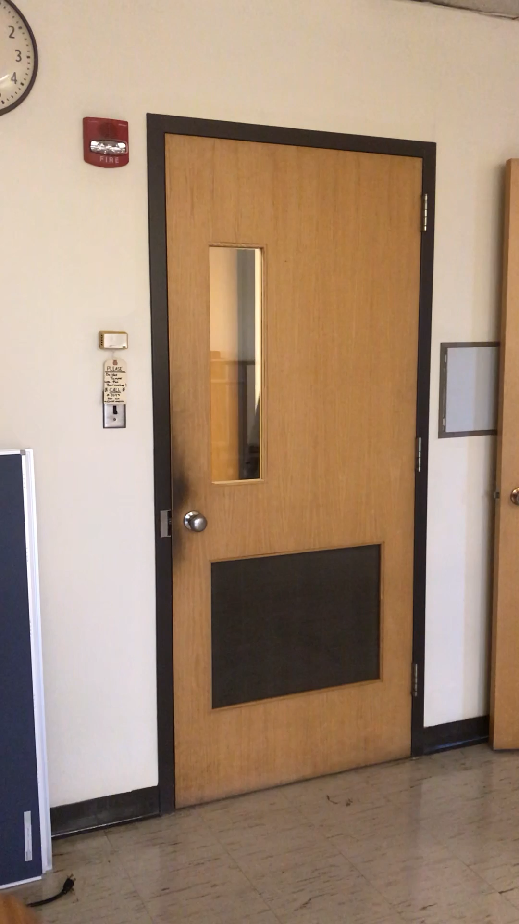
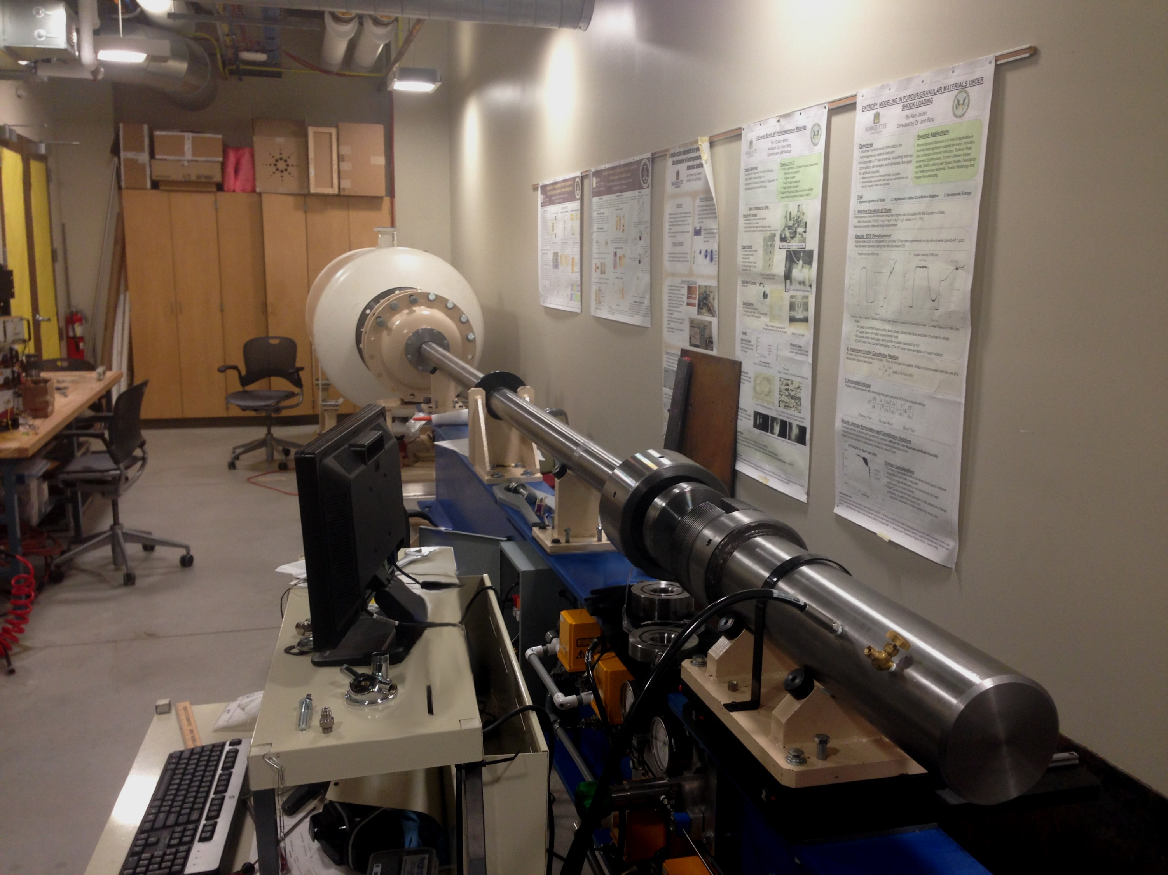
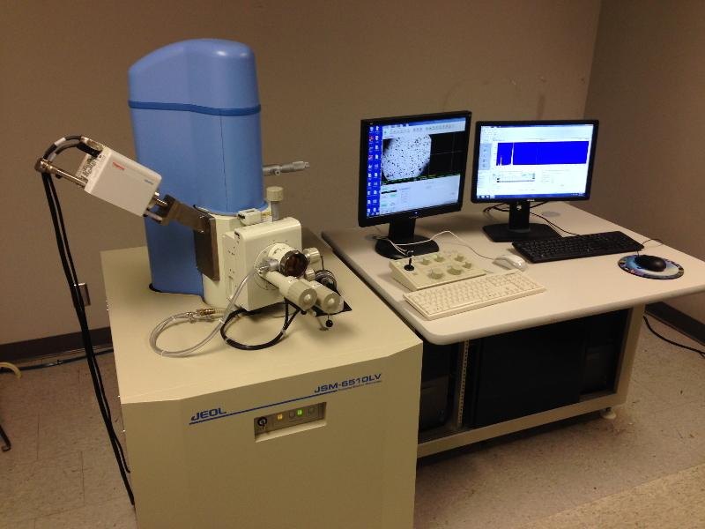
Motivation - Side Problem
Notes:
So I have had another problem that’s a bit difficult to ignore…my brother is working on his PhD in the Shock Physics Lab. His work is on uniaxial strain and oblique impact studies to characterize stress and strain states for sandstone; launching samples with a pneumatic accelerator, which you can only really do once. To characterize samples for better simulation he used the university’s scanning electron microscope.

Slide 4
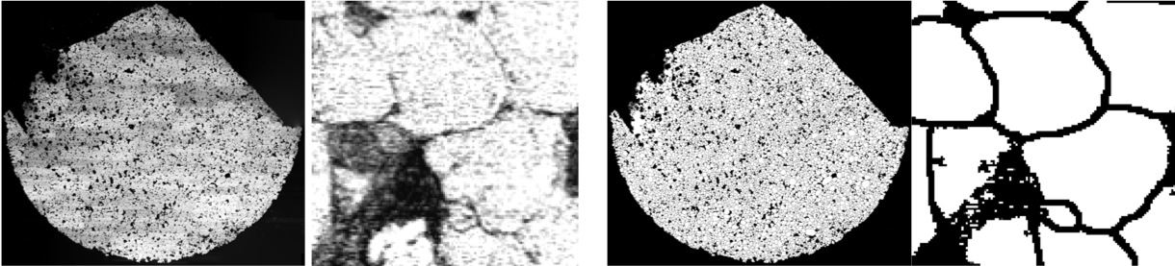
Motivation - Side Problem
Non-homogeneous chemical composition -> uneven light distribution
Wisconsin Ave. Construction -> vibration -> blurry image
Little-to-no positional context
Notes:
And promptly had a lot of issues in isolating grain boundaries with traditional thresholding. Sandstone is quite non-homogeneous, and there was construction going on when he did the scan.

Slide 5
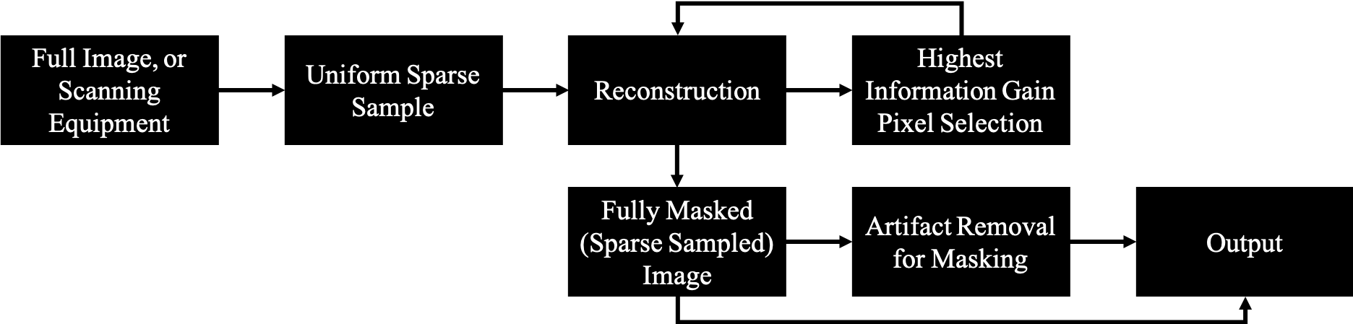
General Approach
Notes:
The solution is the same. You use a machine learning model to perform a reconstruction of the full image selecting only pixels to improve information gain. This gives both predictions of where additional scanning should be done in a sample and also happens to create a binary mask.

Slide 6
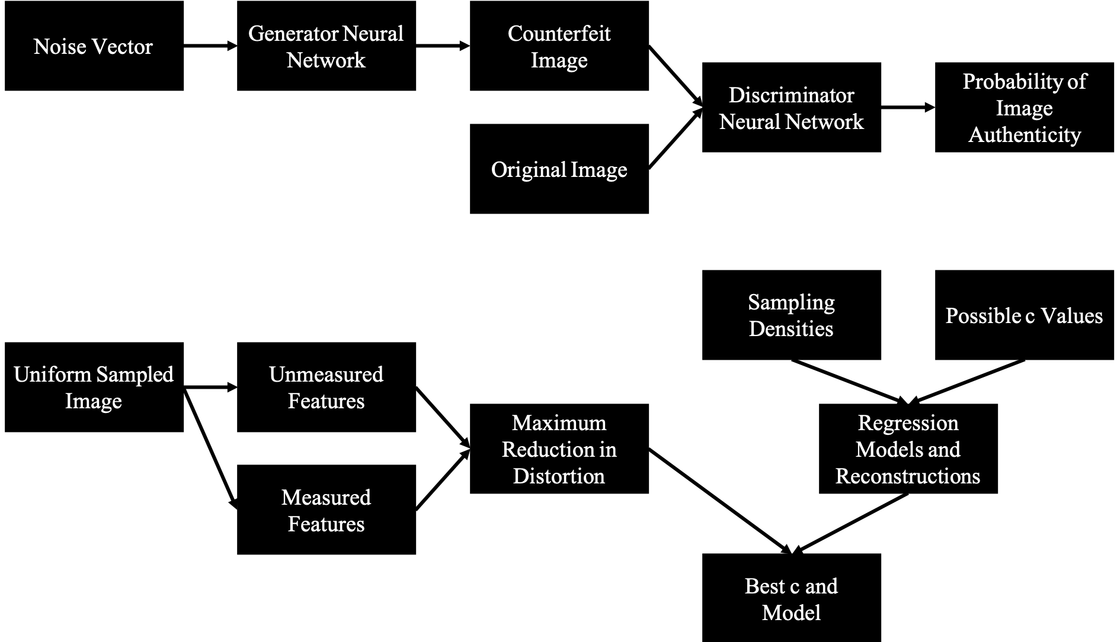
Specific Approaches
GAN
Generative Adversarial Network
SLADS
Supervised Learning Approach for Dynamic Sampling
Notes:
An existing linear modeling approach is SLADS, that selects pixels that maximize the minimization of total distortion in a given image, but this does have limitations that can be theoretically overcome with more advanced models such as the GAN framework.

Slide 7
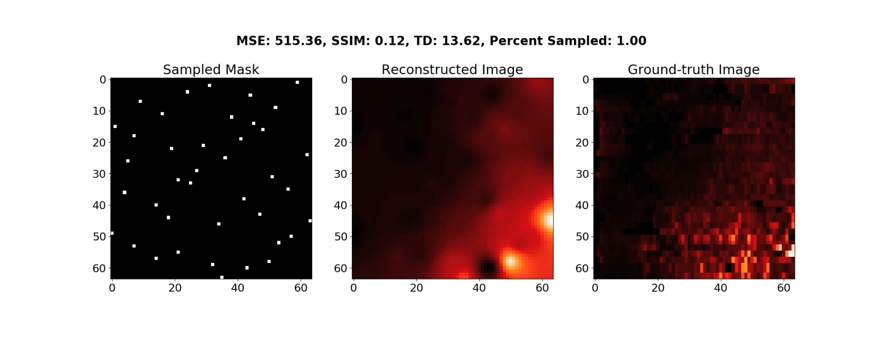
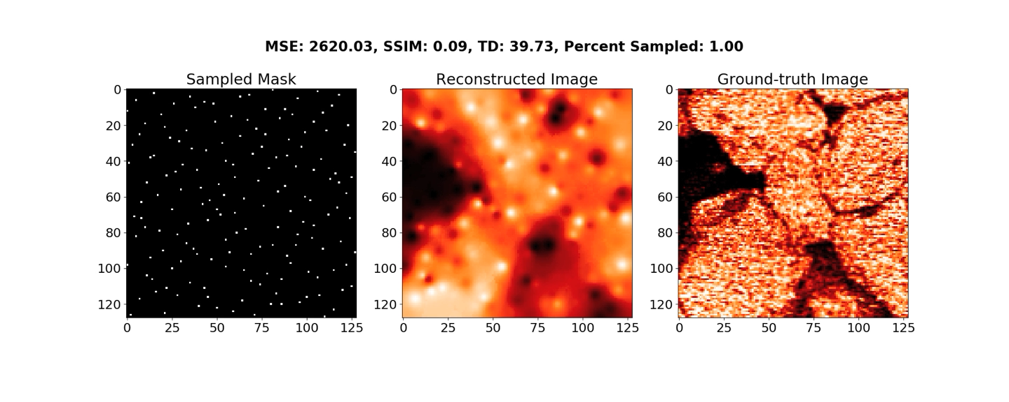
SLADS
Notes:
So here’s SLADS as it operates on the Pancreatic set on top and sandstone on the bottom

Slide 8
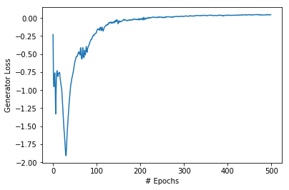
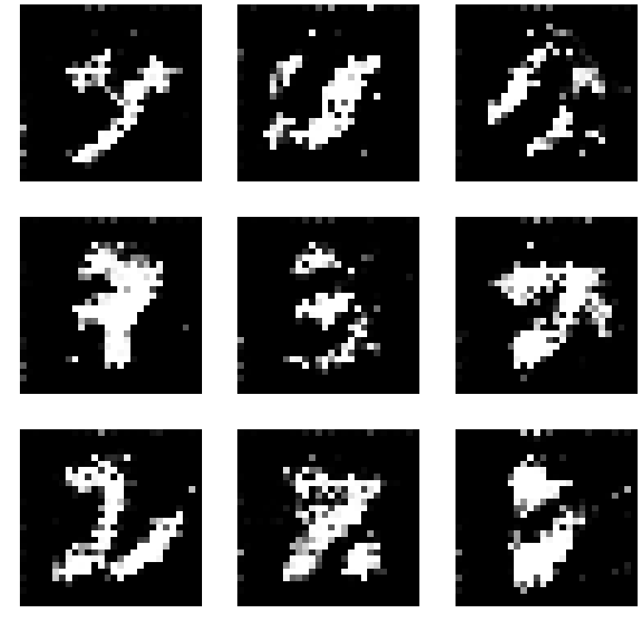
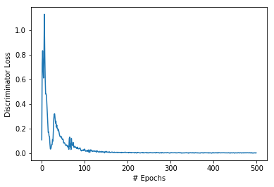
Generative Adversarial Network - GAN
GAN - 2014
Generator NN
Discriminator NN
Deep Convolutional GAN (DCGAN) - 2018
Convolutional windows for 2D data
Initial MNIST Testing
Notes:
The generative adversarial network comprises 2 sub networks. The generator takes in a noise and produces fake results and the discriminator determines how likely it is that a result is real or fake. Convolutional windows extend this to 2 dimensions. Initial testing was done with MNIST and can be seen to converge quite nicely.

Slide 9
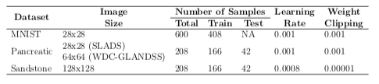
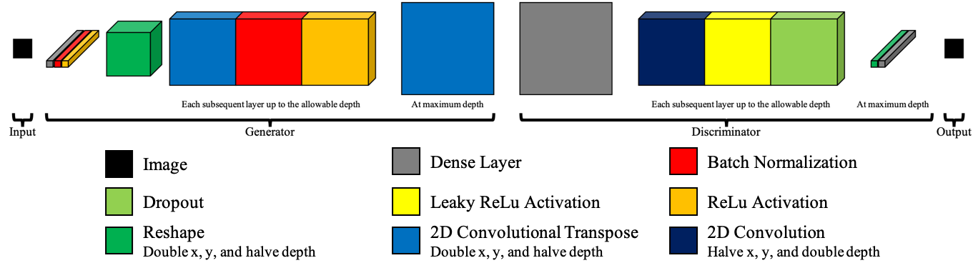
WDC-GLANDSS
Wasserstein GAN (WGAN)
Reduce mode collapse
Eliminate momentum based training
WDC-GLANDSS = SLADS+DCGAN+WGAN
Notes:
However, GANs are ridiculously sensitive, having exploding gradients, or drastic overfitting in mode collapse. WGANs reduce these risks with significant architecture changes. Overall for this procedure, after training, for each pixel added to the reconstruction, an input vector has to be optimized to produce reconstructions containing those pixel values using gradient descent.

Slide 10
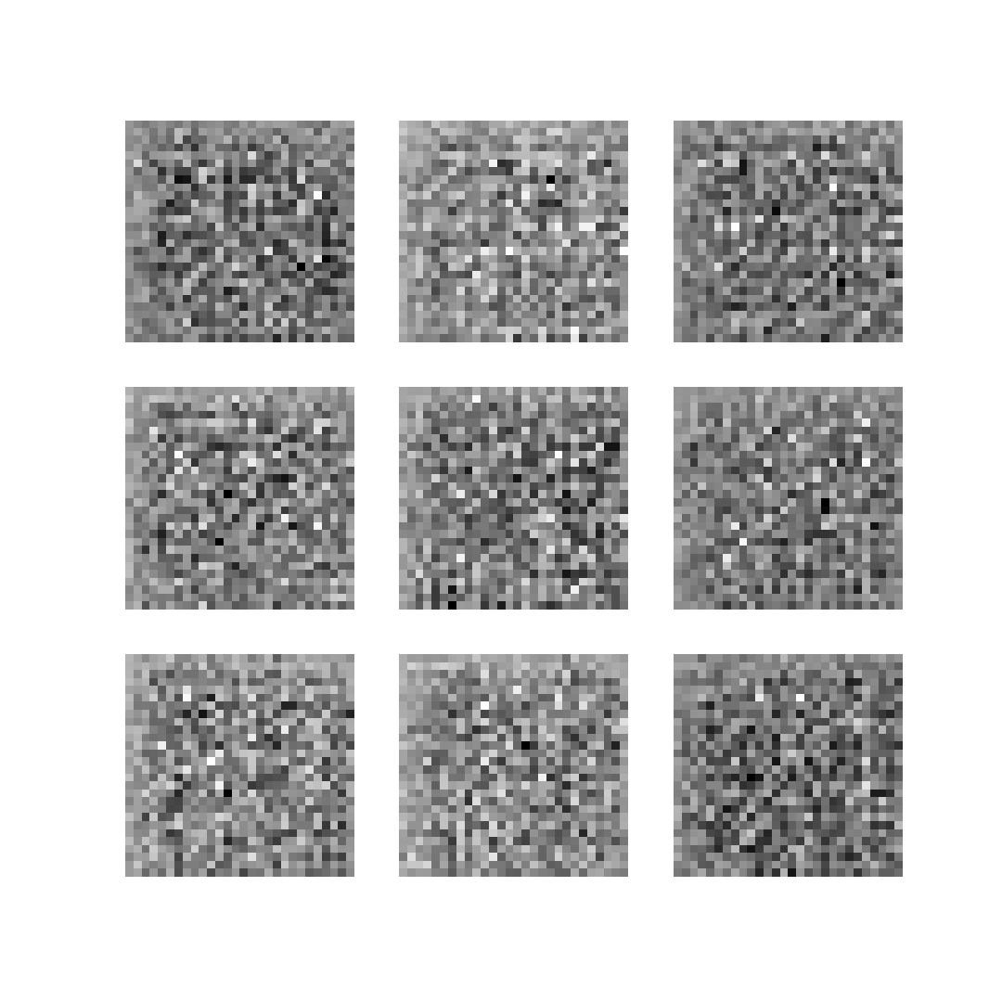
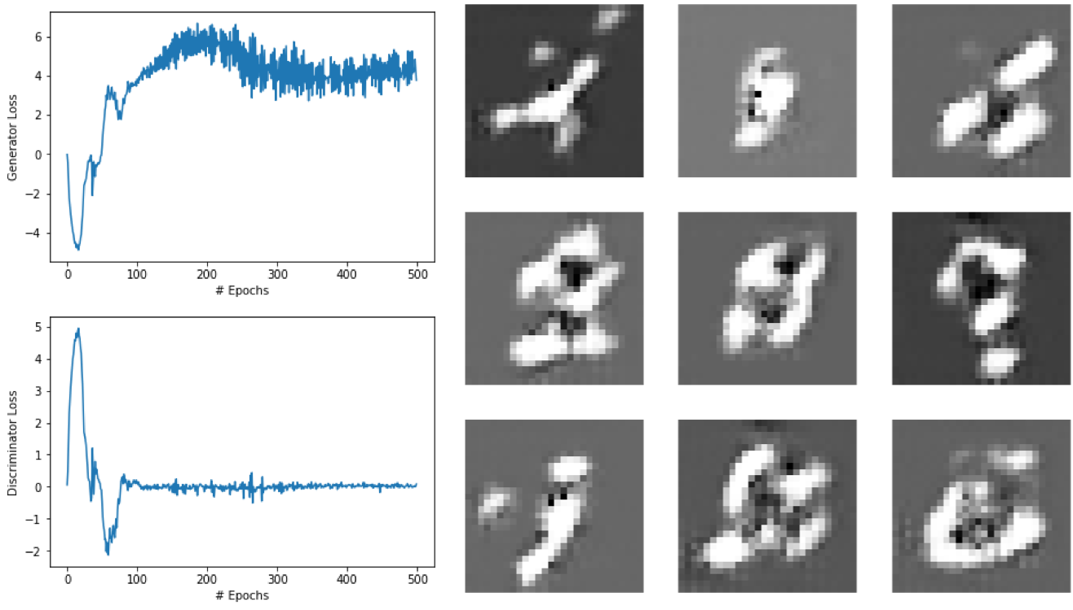
WDC-GLANDSS
Notes:
So for MNIST this works alright, but not so well for the other sets.

Slide 11
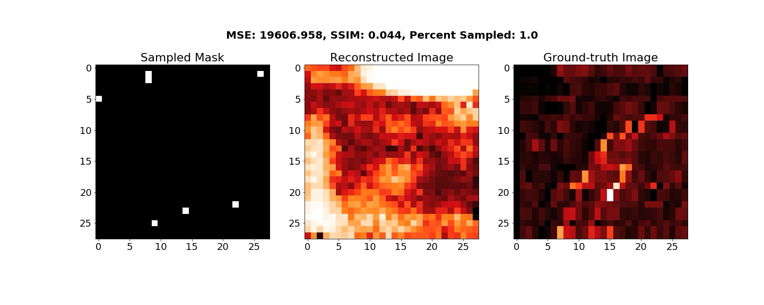
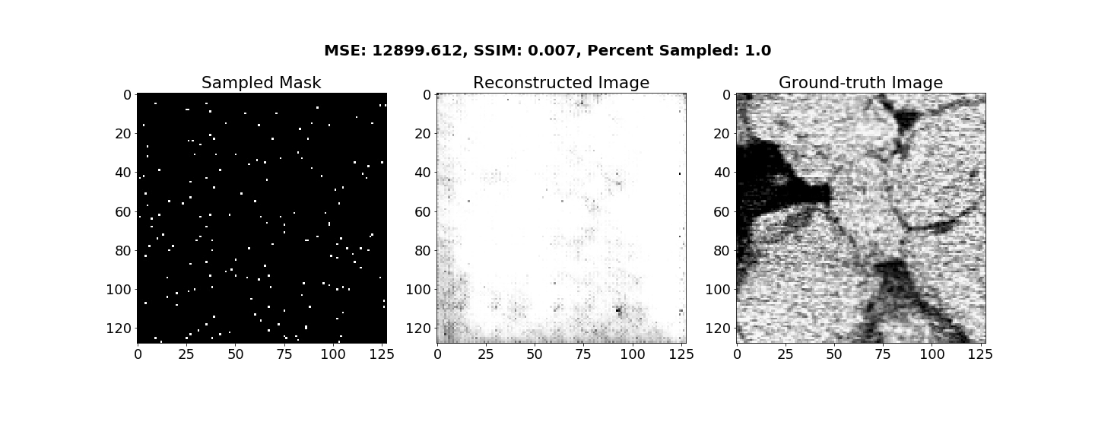
WDC-GLANDSS
Notes:
Both experience some degree of mode collapse.

Slide 12
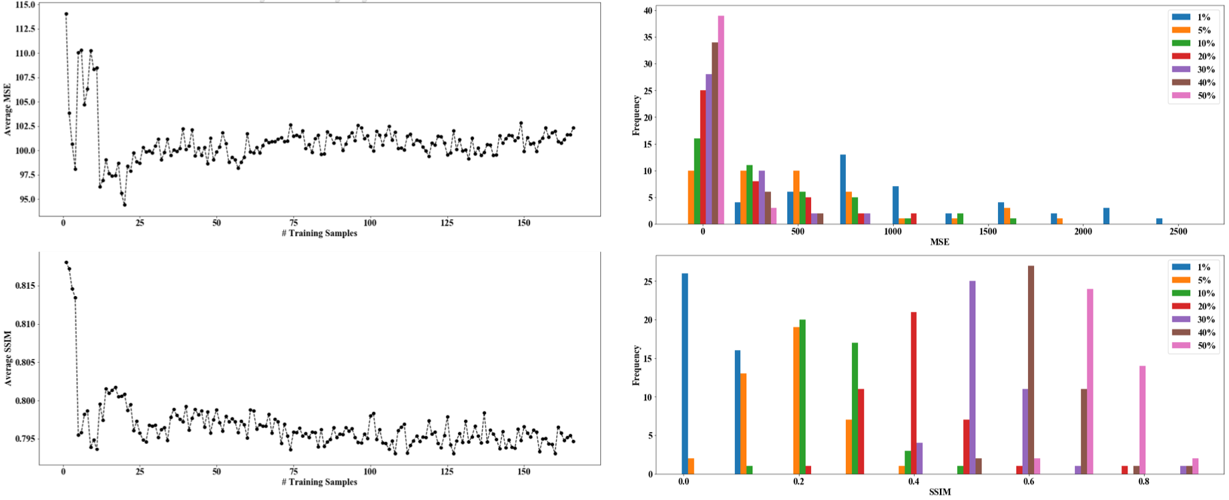
SLADS Results – Pancreatic Islets Reconstruction
Notes:
Starting with SLADS on the pancreatic set, on the left here, MSE and SSIM levels were averaged over all of the testing data for each training sample added. Even though SLADS produces good results and it can be seen to converge, its performance peaks with only a couple training samples. On the right is the distribution for the testing data and you can observe that the more data sampled the better the reconstruction.

Slide 13
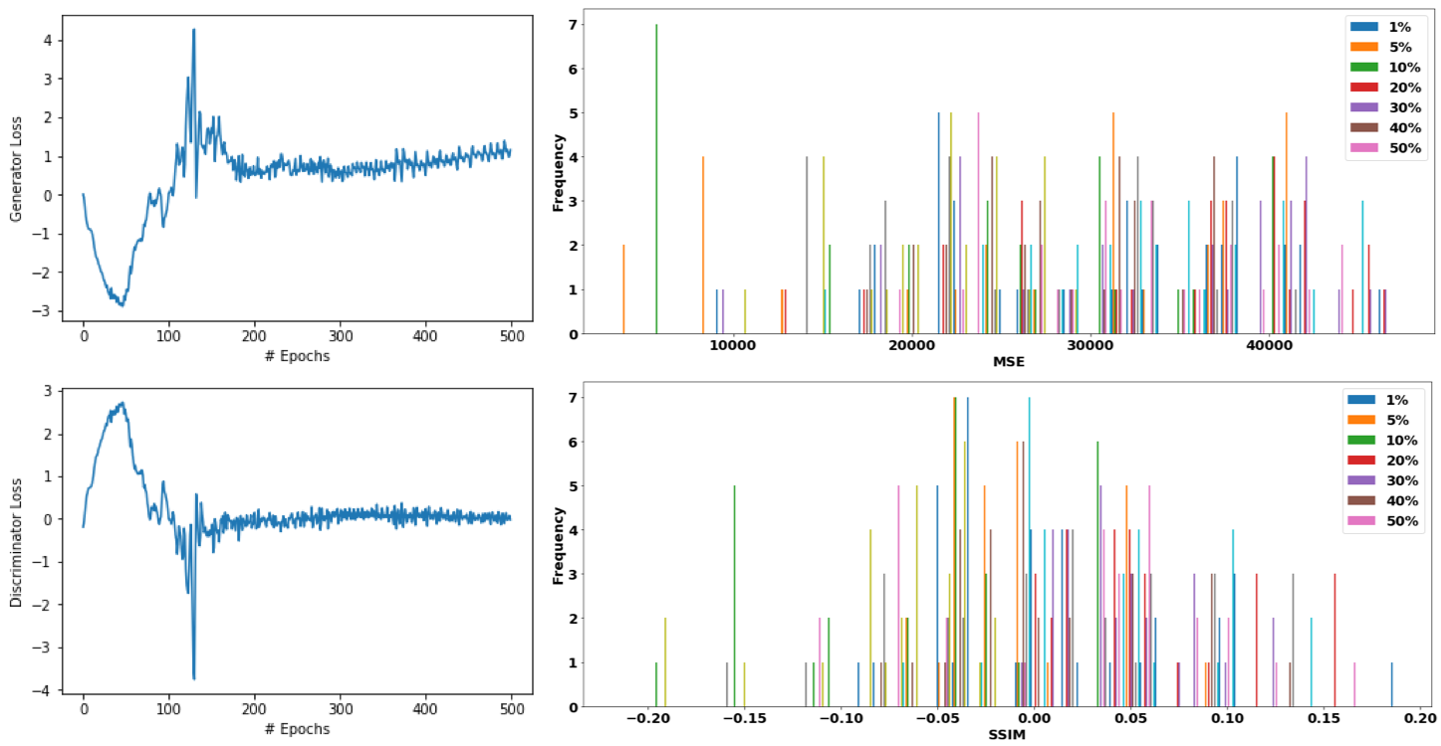
WDC-GLANDSS Results – Pancreatic Islets Reconstruction
Notes:
The GAN failed miserably despite converging.

Slide 14
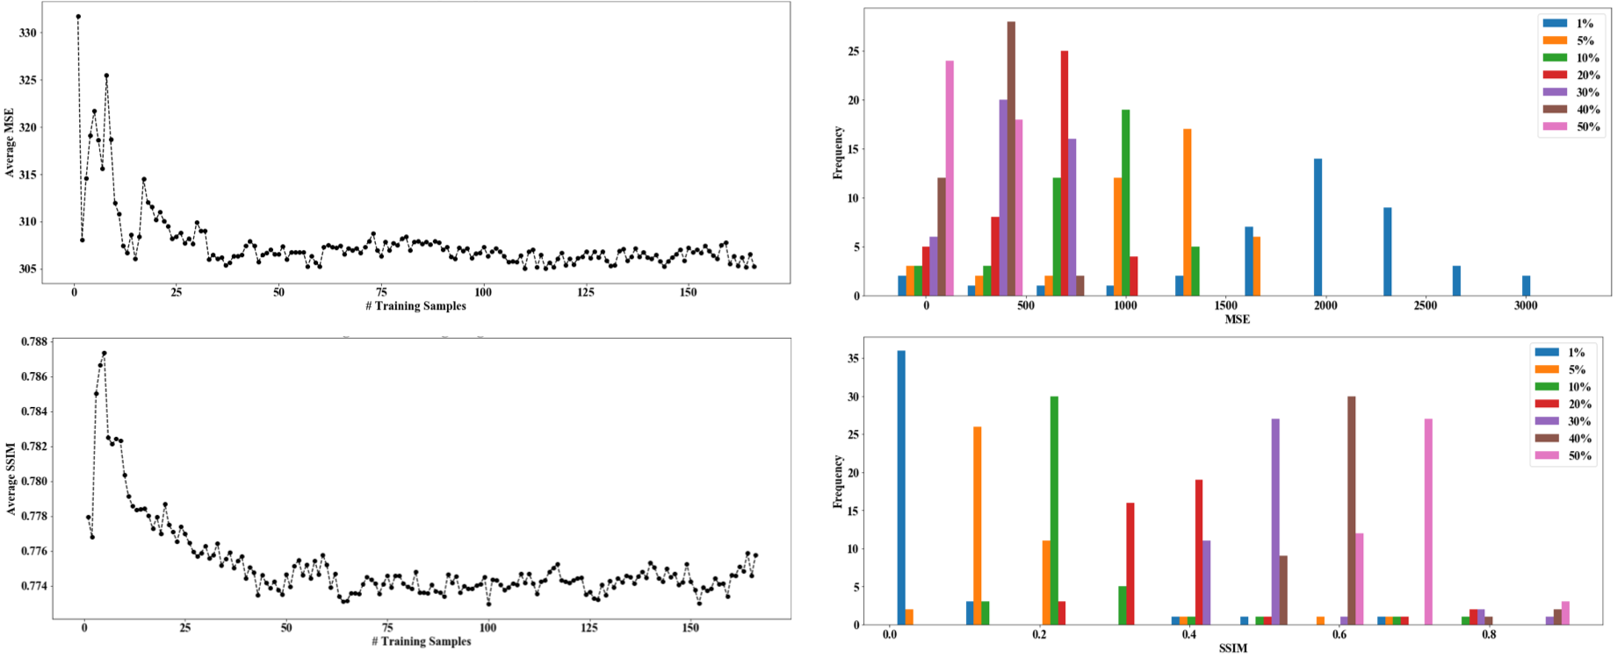
SLADS Results – Sandstone Reconstruction
Notes:
SLADS performed equally well for the sandstone reconstruction.

Slide 15
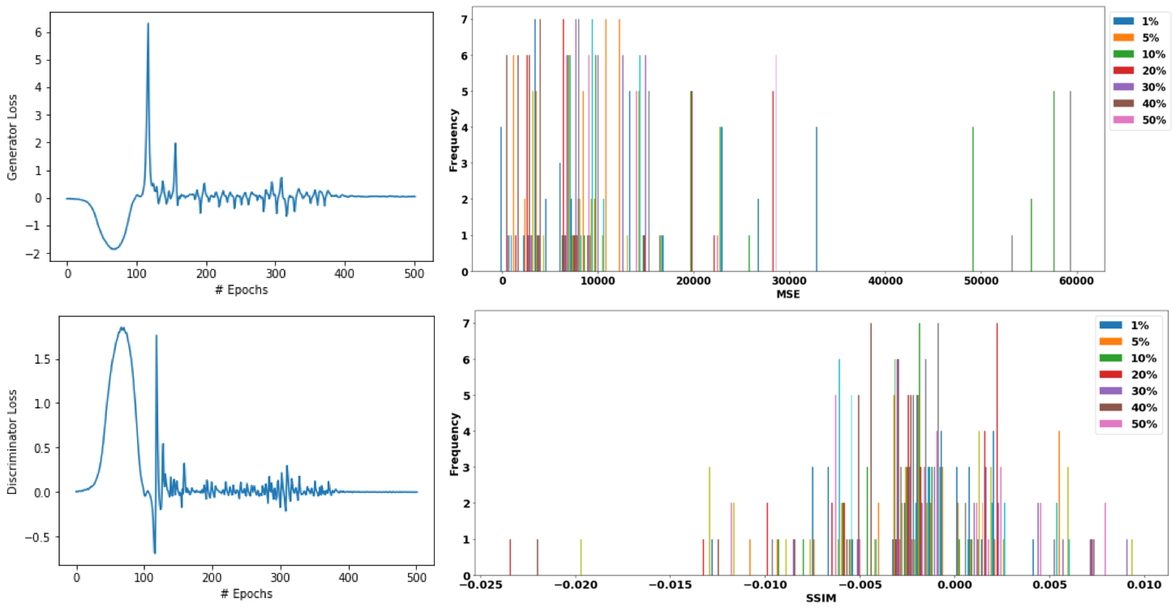
WDC-GLANDSS Results – Sandstone Reconstruction
Notes:
And the GAN once again failed magnificently.

Slide 16
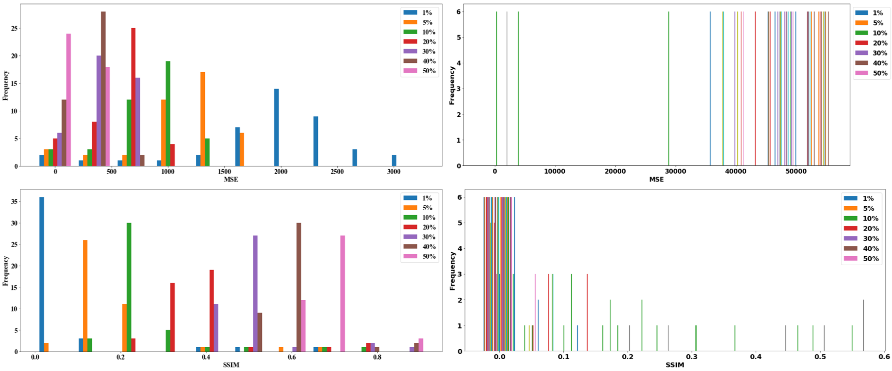
Results – Sandstone Masking
SLADS
WDC-GLANDSS
Notes:
Comparing generated binary masks against those manually performed, SLADS actually does a really good job and the GAN continues its convalescence.

Slide 17
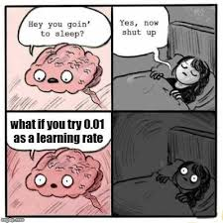
The Future
Notes:
Future work aims to tease out better parameters and loss functions for the GAN, possibly implementing a gradient penalty method and some in-training adjustment of the learning rate.
SLADS is currently bound to the CPU though improved with multithreading, so I would like to add GPU support to it.

Slide 18
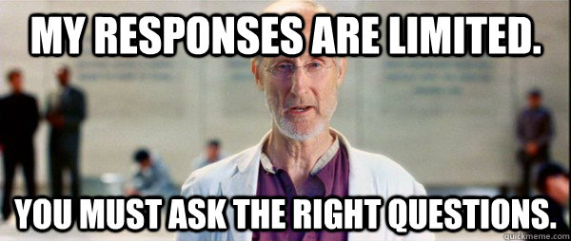
Questions

